Slide 1

Stockify
Model for Estimating Stock Performance
By: Abdullah salau

Slide 2
Brief Overview
Predicting Stock Performance with Python & SciKit Learn Modules
Algorithm processing and preprocessing
Binary Classification (Part 1)
Regression Analysis on Stock Value (Part 2)
Notes:
Stockify is a program containing estimation models designed to predict whether or not a particular stock is worth buying (ie. its value will increase) at the end of a year based on numerous financial indicators that act as the model’s independent variables. The program includes multiple binary classification algorithms for prediction, but also showcases algorithm performance results to determine which model works best with an existing dataset that includes stock information from 2014-2018.
Stockify also contains models to predict one of the nominal financial indicators included in the dataset. Similar to the binary classification problem, Stockify also includes the algorithm performance results for each model designed to predict the nominal financial indicator to determine the highest performing algorithm.

Slide 3
The Datasets
5 Datasets (2014-2018)
225 columns (1 ID column, 223 Predictors, 1 Class Variable)
3808 records

Slide 4
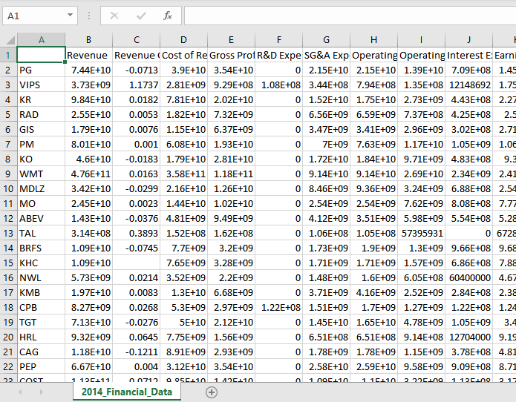
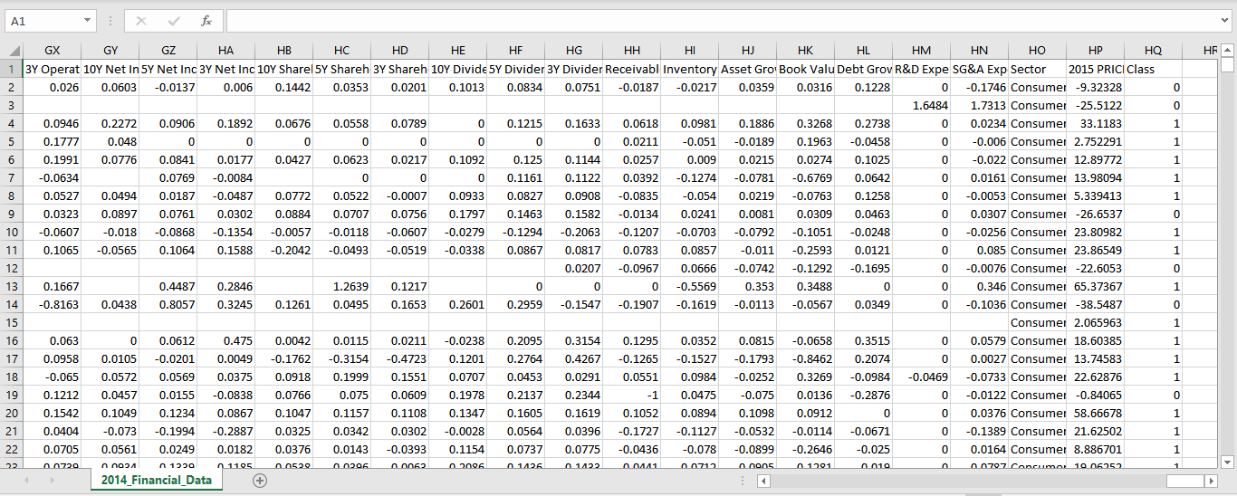
Notes:
The last column of the dataset represents the class of each stock, where:
if the value of a stock increases during 2015, then class=1;
if the value of a stock decreases during 2015, then class=0.

Slide 5
Cleaning the Dataset

Slide 6
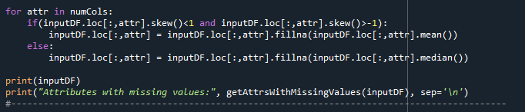
Handling Class and Label Column
Handling Problematic Columns
Handling Missing Values
Notes:
Problematic Columns- Columns that had no values except 1 or 2, columns with the same values
Missing Values- If the skewness is between -1 and 1, the data are fairly symmetrical. Therefore, we use mean to fill in missing values
Otherwise, use median

Slide 7
Handling Categorical Variable (Sector)
Notes:
We use Built in function for One Hot Encoding (pd.get_dummies

Slide 8
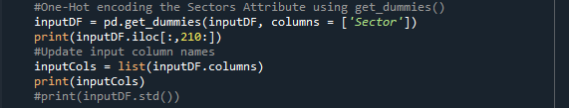

Slide 9
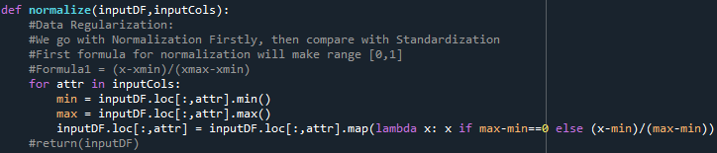
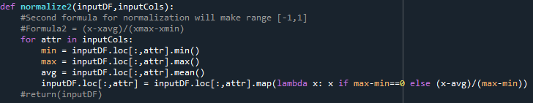


Data Regularization
Two techniques for Normalization
$x_{new}=\frac{x−x_{min}}{x_{max}−x_{min}}$ and $x_{new}=\frac{x−x_{avg}}{x_{max}−x_{min}}$
Standardization
$$x_{new}=\frac{x−x_{avg}}{x_{std}}$$
$$x_{std}=\sqrt{\frac{1}{m}\sum_{i=1}^{m}{{\left(x^{(i)}−x_{avg}\right)}^{2}}}$$
Notes:
After building logistic model, we test each, no difference in performance results

Slide 10
Logistic Model

Slide 11
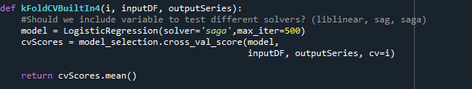
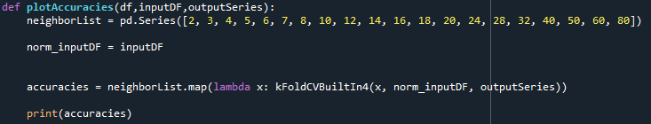
Building LogisticRegression object and running K-Cross Fold Validations:
Notes:
Solver = ‘saga’
Accuracies for different K

Slide 12
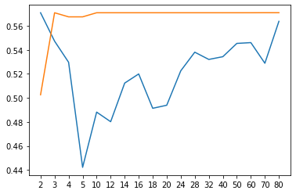
Preprocessed vs Unprocessed
Accuracy
CV

Slide 13
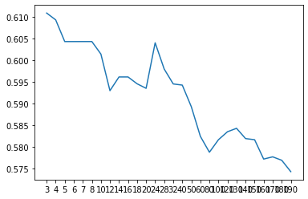
Using selectKBest for Feature Selection (Logistic)
Score
Number of estimators

Slide 14
Other Models Experimented
K-Nearest Neighbor
Gradient Boosting
Random Forests*
LightGM
XGBoost

Slide 15
Random Forests Model

Slide 16
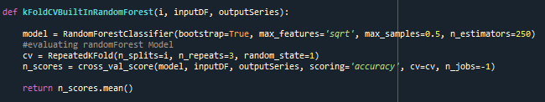

Slide 17
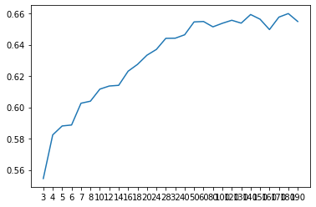
Using selectKBest for Feature Selection (RFM)
Score
Number of estimators

Slide 18
Regression vs Classification

Slide 19
Multiple Linear Regression Model

Slide 20
Before Preprocessing (r2 score)
For cv= 5.000, mean is -192480516.592
For cv= 10.000, mean is -25035066608.244
For cv= 20.000, mean is -54147159946.297
For cv= 30.000, mean is -28666577129.083
For cv= 40.000, mean is -38450797215.902
For cv= 50.000, mean is -21208697684.553
For cv= 70.000, mean is -11132006438.947
For cv= 100.000, mean is -24039503040.749
For cv= 200.000, mean is -17614185338.130
For cv= 500.000, mean is -7464612004.326
Notes:
No Preprocessing, all the features (223) will carry weight in the model

Slide 21
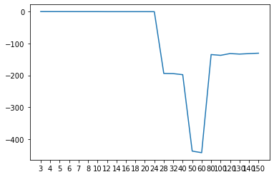
After Preprocessing
[-0.5510104267321101, -0.5690084582323335, -0.5782817374788073, -0.6015329023382818, -0.6156079451670707, -0.6172877526062723, -0.6345085534431991, -0.73985454690197, -0.7409099818184244, -0.7450067050793995, -0.7438626999506054, -0.7439557374788219, -0.787262998096854, -194.10353788252726, -194.64211467802426, -197.96738000735002, -437.1132242388515, -442.0217283922878, -134.96779029429828, -137.42633136483272, -131.85000351476452, -133.53320543418937, -132.01299235179403, -130.73056421980732
SelectKBest features
Log transformations
Score
Features

Slide 22
Other Models Experimented
Ridge Regression*
Lasso Regression
Random Forests

Slide 23
Ridge Model

Slide 24
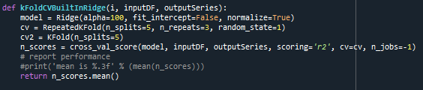

Slide 25
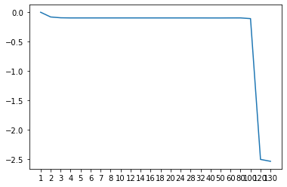
Using selectKBest for Feature Selection (Ridge)
Score
-0.006449834410345515, -0.08662956618229559, -0.10043884843905818, -0.10305508475277862, -0.1030518791888775, -0.10305445218298405, -0.10305442334549217, -0.1030477680868948, -0.10303258944526164, -0.10296779599969016, -0.10300079915159707, -0.10299715998533873, -0.10307095755522583, -0.10310686912179116, -0.10316215095128035, -0.10320723360475043, -0.10319966687323508, -0.10354279336792889, -0.10373258855402406, -0.10293668372075696, -0.10268606025913418, -0.11440663873540523, -2.509321884941376, -2.5413456548347275
Number of estimators

Slide 26
Thank you!

